Slide 1
CNN ARCENE DATASET
BY: SWASTIK GUPTA
MANISH KUMAR

Slide 2
Convolutional neural networks are distinguished from other neural networks by their superior performance with image, speech, or audio signal inputs. They have three main types of layers, which are:
Convolutional layer
Pooling layer
Fully-connected (FC) layer
The convolutional layer is the first layer of a convolutional network.
With each layer, the CNN increases in its complexity, identifying greater portions of the image.

Slide 3
Let’s assume that the input will be a color image, which is made up of a matrix of pixels in 3D. This means that the input will have three dimensions—a height, width, and depth—which correspond to RGB in an image.
The feature detector is a two-dimensional (2-D) array of weights, which represents part of the image.
Afterwards, the filter shifts by a stride, repeating the process until the kernel has swept across the entire image.

Slide 4
There are three hyperparameters which affect the volume size of the output that need to be set before the training of the neural network begins. These include:
1. The number of filters affects the depth of the output. For example, three distinct filters would yield three different feature maps, creating a depth of three.
2. Stride is the distance, or number of pixels, that the kernel moves over the input matrix. While stride values of two or greater is rare, a larger stride yields a smaller output.
3. Zero-padding is usually used when the filters do not fit the input image. This sets all elements that fall outside of the input matrix to zero, producing a larger or equally sized output. There are three types of padding:
Valid padding: This is also known as no padding. In this case, the last convolution is dropped if dimensions do not align.
Same padding: This padding ensures that the output layer has the same size as the input layer
Full padding: This type of padding increases the size of the output by adding zeros to the border of the input.

Slide 5
POOLING LAYER
Pooling layers, also known as downsampling, conducts dimensionality reduction, reducing the number of parameters in the input.
Similar to the convolutional layer, the pooling operation sweeps a filter across the entire input, but the difference is that this filter does not have any weights.
Max pooling: As the filter moves across the input, it selects the pixel with the maximum value to send to the output array. As an aside, this approach tends to be used more often compared to average pooling.
A ReLU layer performs a threshold operation to each element of the input, where any value less than zero is set to zero.

Slide 6
Fully-Connected Layer
In the fully-connected layer, each node in the output layer connects directly to a node in the previous layer.
This layer performs the task of classification based on the features extracted through the previous layers and their different filters.
While convolutional and pooling layers tend to use ReLu functions, FC layers usually leverage a softmax activation function to classify inputs appropriately, producing a probability from 0 to 1.
The softmax function is a function that turns a vector of K real values into a vector of K real values that sum to 1. The input values can be positive, negative, zero, or greater than one, but the softmax transforms them into values between 0 and 1, so that they can be interpreted as probabilities.

Slide 7
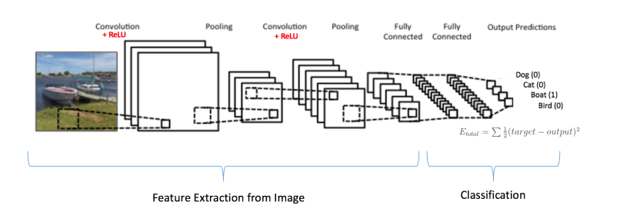

Slide 8
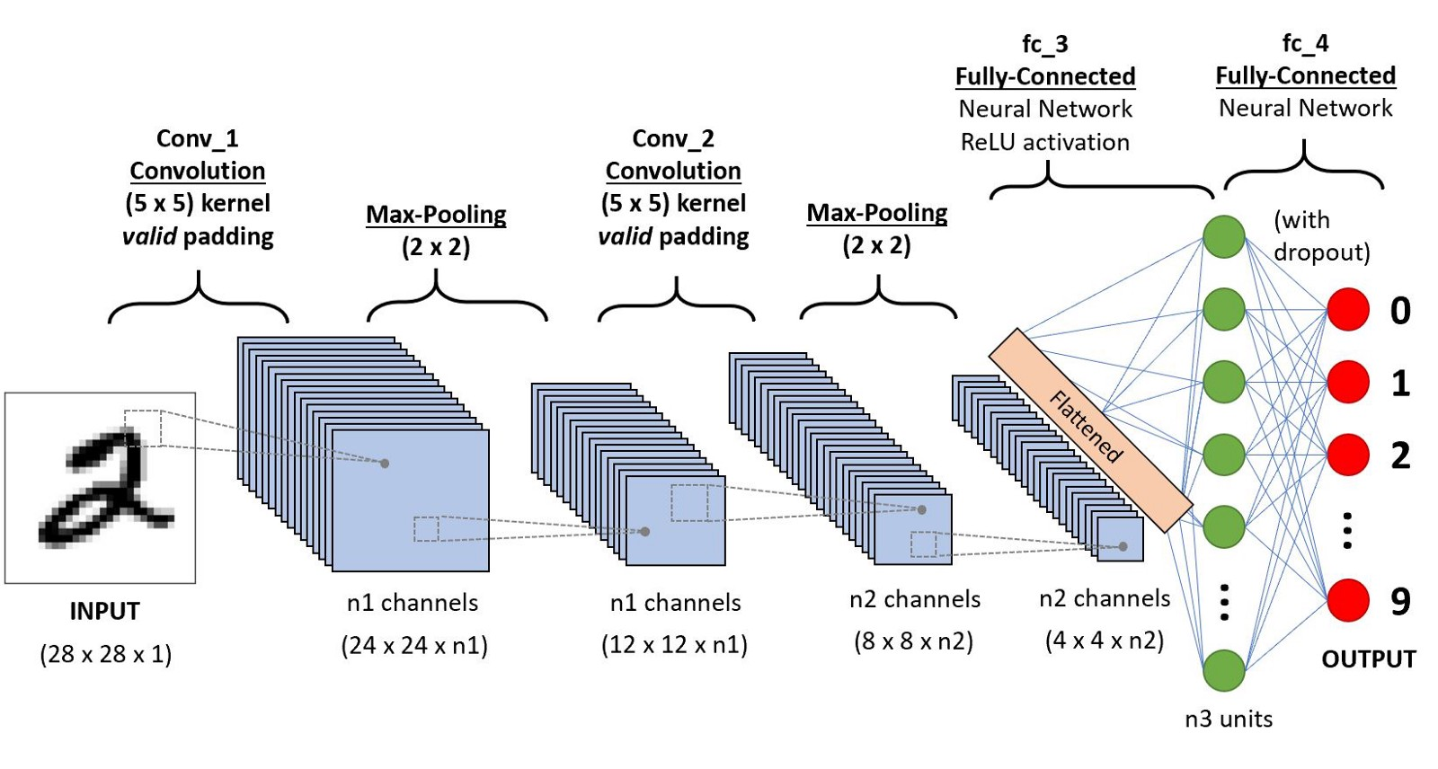

Slide 9


Slide 10
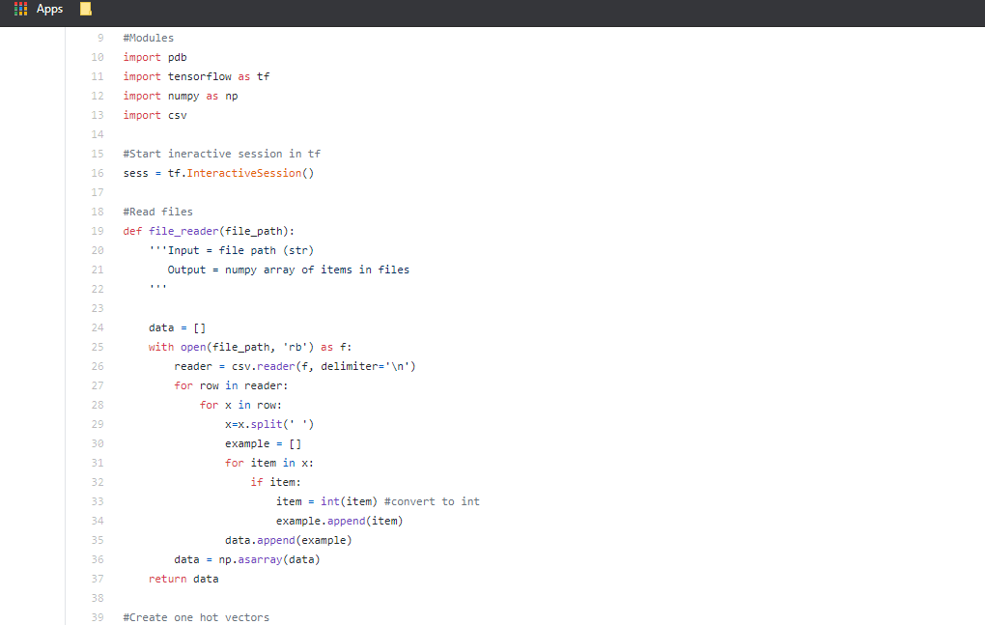

Slide 11
TensorFlow is based on graph computation; it allows the developer to visualize the construction of the neural network with Tensorboad.
The very first reason to prefer python numpy arrays is that it takes less memory as compared to the python list. Then, it is fast in terms of execution and at the same time, it is convenient and easy to work with it.
CSV files are plain-text files, which makes them easy for the website developer to create. Because the CSV is plain-text it can be imported into any spreadsheet program or database

Slide 12
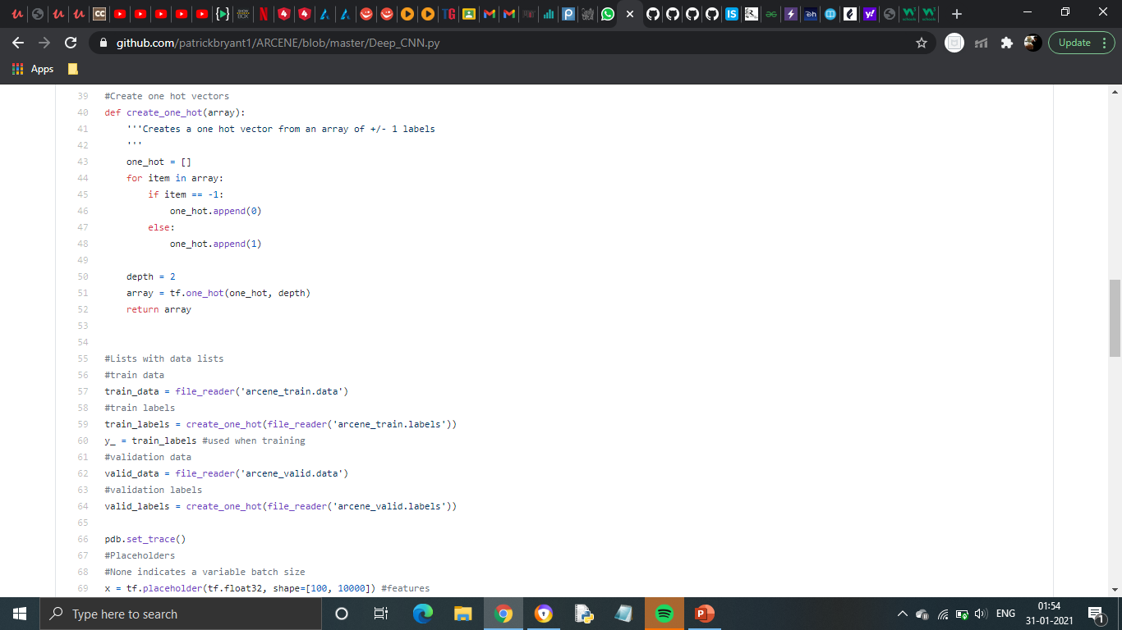

Slide 13
Sometimes in datasets, we encounter columns that contain numbers of no specific order of preference. The data in the column usually denotes a category or value of the category and also when the data in the column is label encoded. This confuses the machine learning model, to avoid this the data in the column should be One Hot encoded.
One Hot Encoding –
It refers to splitting the column which contains numerical categorical data to many columns depending on the number of categories present in that column. Each column contains “0” or “1” corresponding to which column it has been placed.
A placeholder node can be assigned using the tf.placeholder () class to which you can provide arguments such as type of the variable and/or its shape. Placeholders are extensively used for representing the training dataset in a machine learning model as the training dataset keeps changing.

Slide 14
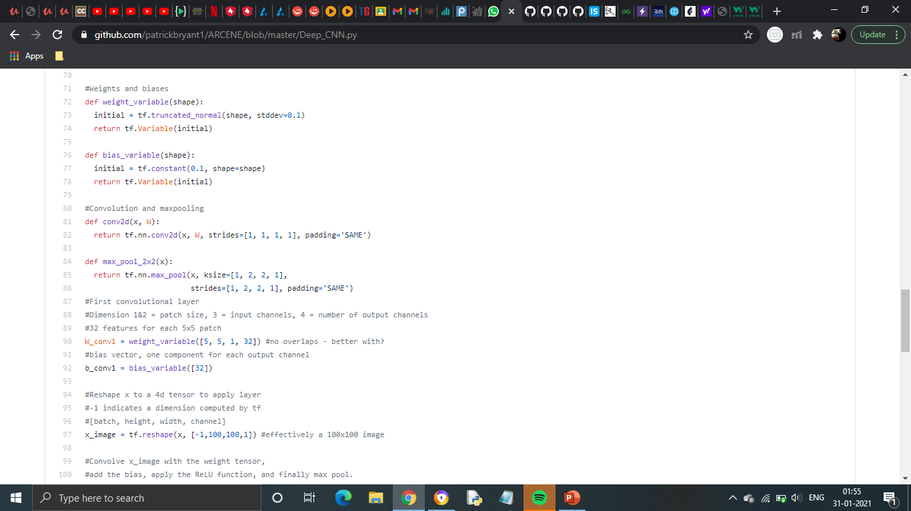

Slide 15
tf.truncated_normal () selects random numbers from a normal distribution whose mean is close to 0 and values are close to 0.
tf.constant:Creates a constant tensor from a tensor-like object.
tf.nn.conv2d () is the TensorFlow function you can use to build a 2D convolutional layer as part of your CNN architecture.
Tf.reshape():Given tensor, this operation returns a new tf.Tensor that has the same values as tensor in the same order, except with a new shape given by shape.

Slide 16
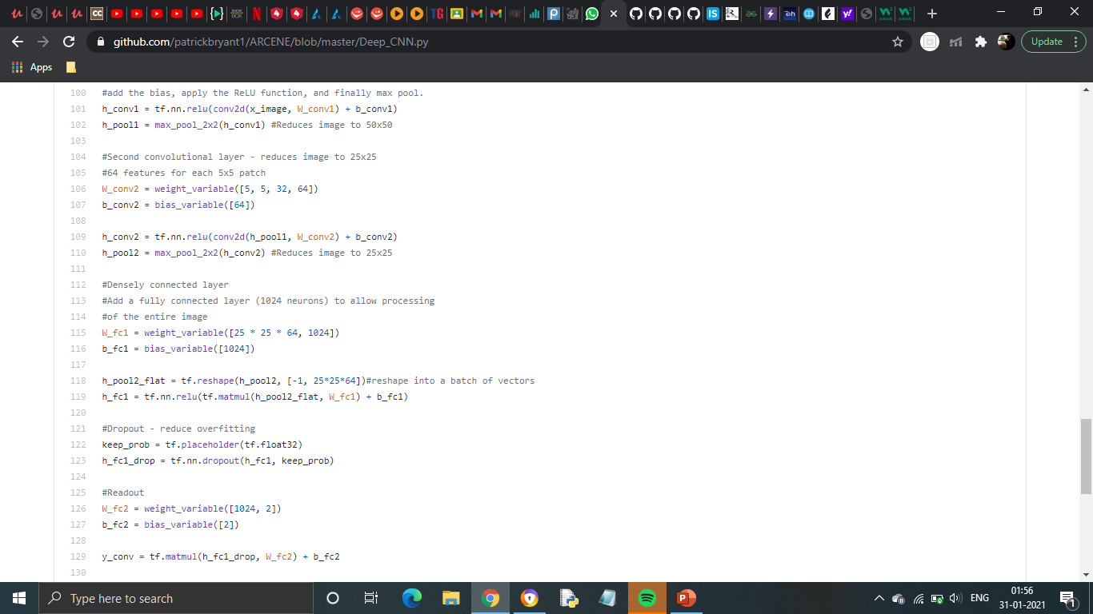

Slide 17
Overfitting occurs when our machine learning model tries to cover all the data points or more than the required data points present in the given dataset.
Underfitting occurs when our machine learning model is not able to capture the underlying trend of the data.
The Dropout layer is a mask that nullifies the contribution of some neurons towards the next layer and leaves unmodified all others.
We can apply a Dropout layer to the input vector, in which case it nullifies some of its features; but we can also apply it to a hidden layer, in which case it nullifies some hidden neurons.
Dropout layers are important in training CNNs because they prevent overfitting on the training data.

Slide 18
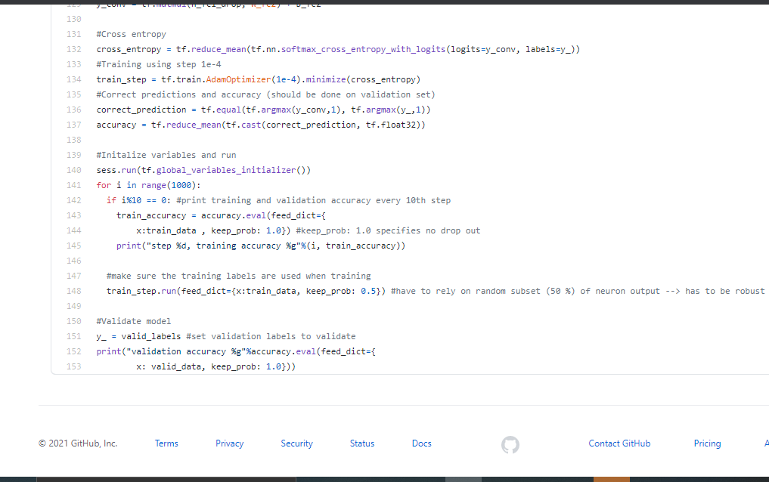

Slide 19
Cross-entropy is a measure of the difference between two probability distributions for a given random variable or set of events.
Optimizers update the weight parameters to minimize the loss function.
Three types of optimizers:
Gradient Descent
RMSProp
Adam
Adam implements the exponential moving average of the gradients to scale the learning rate instead of a simple average. It keeps an exponentially decaying average of past gradients
Adam is computationally efficient and has very little memory requirement
Reducemean:Reduces input_tensor along dimensions given in axis.If axis has no entries, all dimensions are reduced, and a tensor with a single element is returned.

